Slide 1
Speech sounds
“f” “th”
Can often be confused

Slide 2
Mouth is open, tongue sits between teeth, then blow air through them.
Bottom lip is slightly pulled in, teeth sit on outside of bottom lip, then blow air through.
Both are quiet sound.

Slide 3
“f” sound
https://www.youtube.com/watch?v=ZeJDL9XUkRg
“th sound
https://www.youtube.com/watch?v=ixX5WupWwnc
Theses links are from kids you tube, they can be copied and pasted in the search bar to watch.
All links must be supervised by an adult and children should not left alone in order to uphold our commitment to internet safety and the safeguarding of children online.

Slide 4
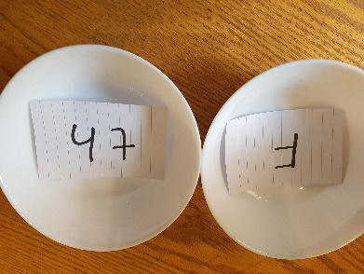
Sound games
Write words which have the “th” and “f” sounds in them, on paper.
Get two bowls or plates. Write the “f” and “th” sound on a post it or small piece of paper. Place one in each bowl/plate.
Read out the words in random order, ask your child to point to which sound they think the word contains, put the word in that bowl/plate face down.
Once all the words have been read out, take them out of the bowl/plate and see which ones were correctly placed in each sound.

Slide 5
“th” words
Throw Thread Brother Earth
Think Teeth Path Mouth
Thin With Cloth Thief
Three Bath Thirteen Weather
Thursday Thunder Thirty Both
Throat Smooth Birthday Thick
Thirsty Mother Toothpaste Thumb
Maths Father Moth There

Slide 6
“f”words
Feet Fox Stuffing Fan
Fingers Fairy Coffee Four
Fork Five Leaf Sofa
Fish Fifty Wolf Fog
Fast Fire Scarf Free
Food Muffin Chef Foam
Fat Waffle giraffe Fudge
Fan Traffic Calf Foot

