Slide 1
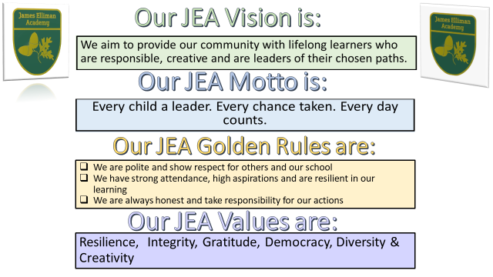

Slide 2
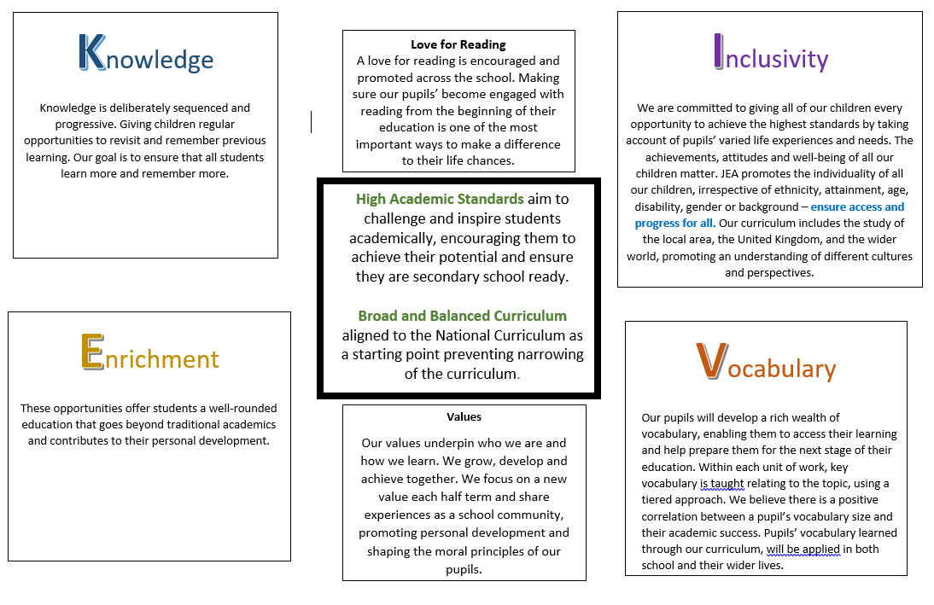

Slide 3
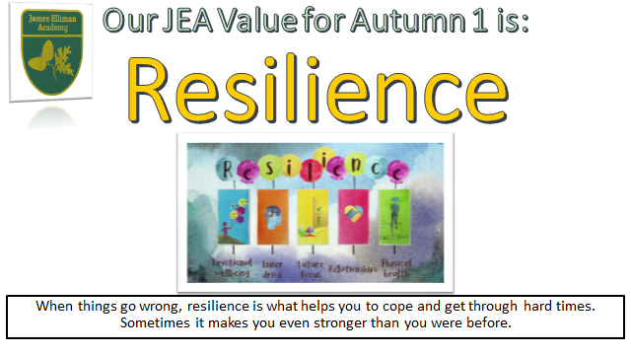

Slide 4
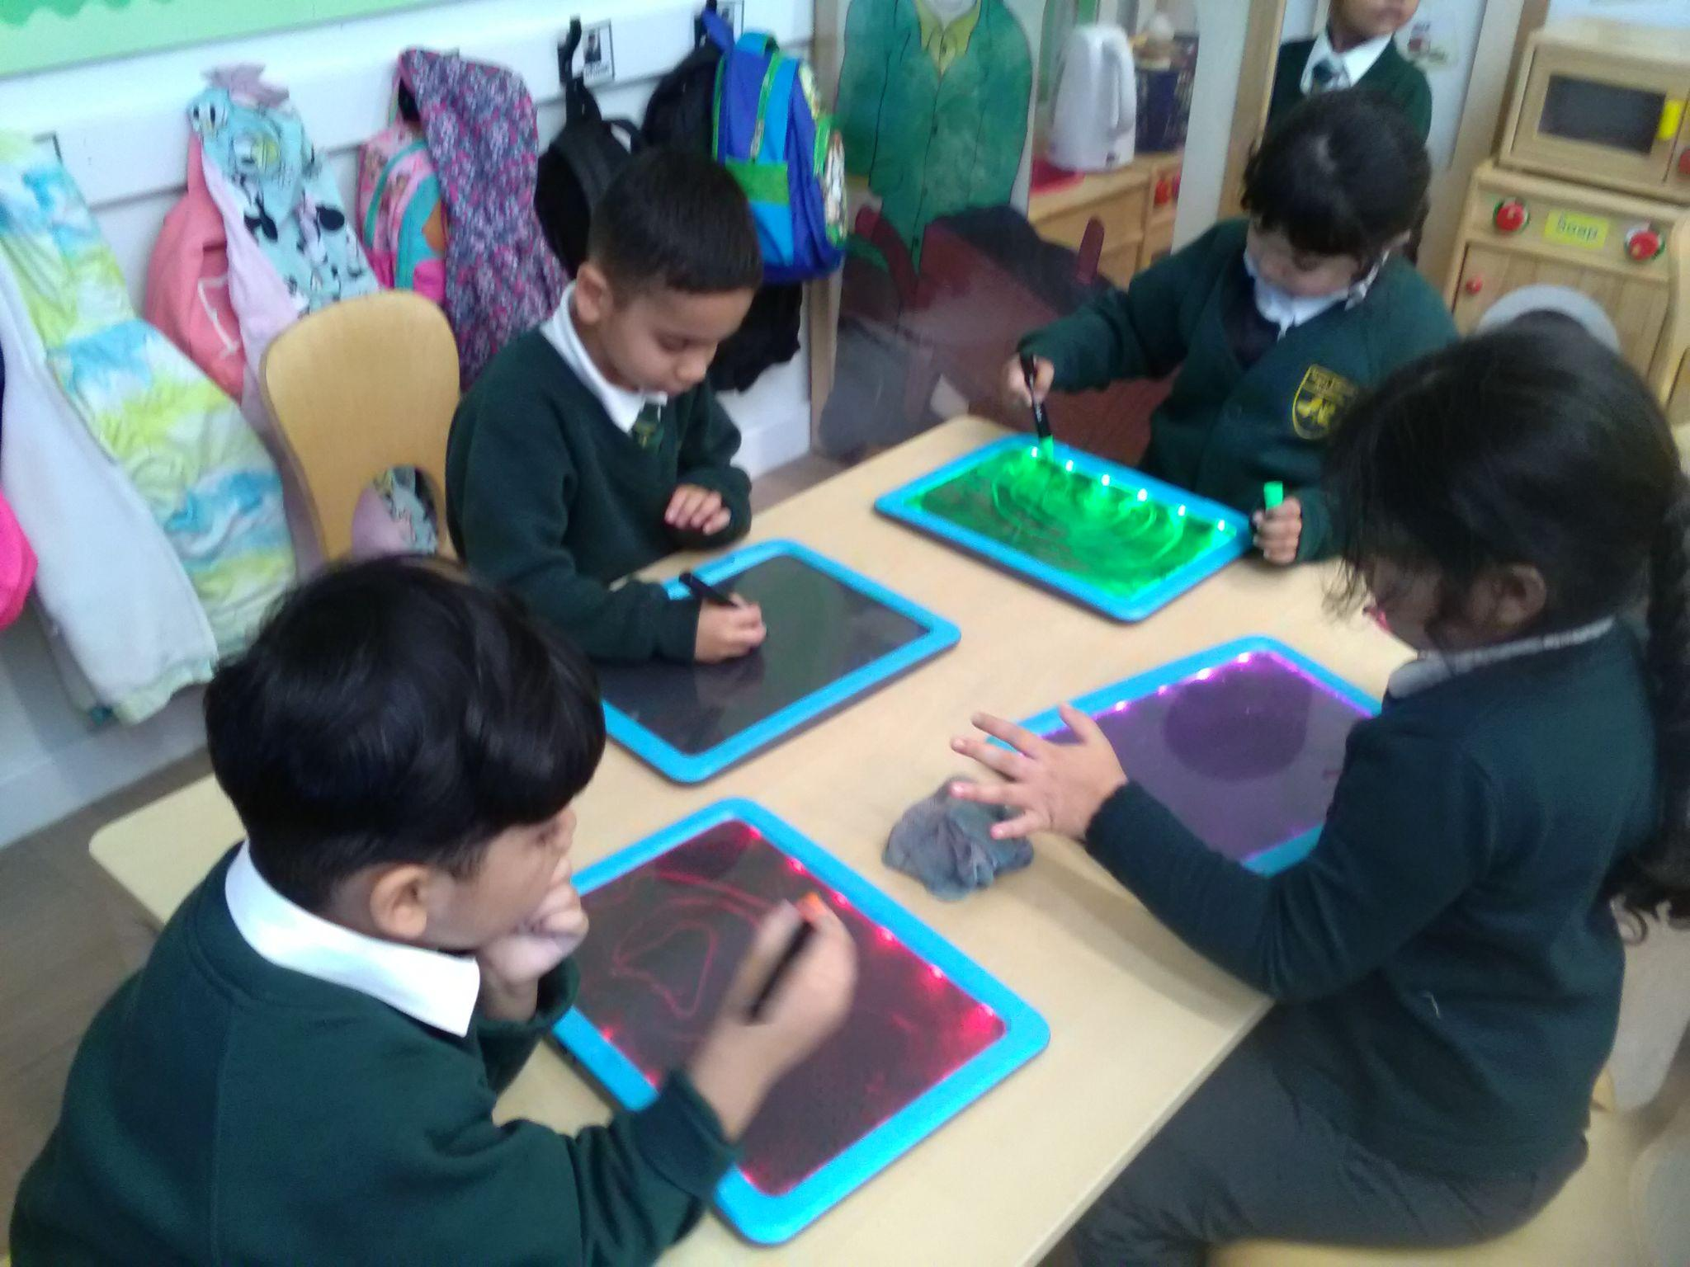
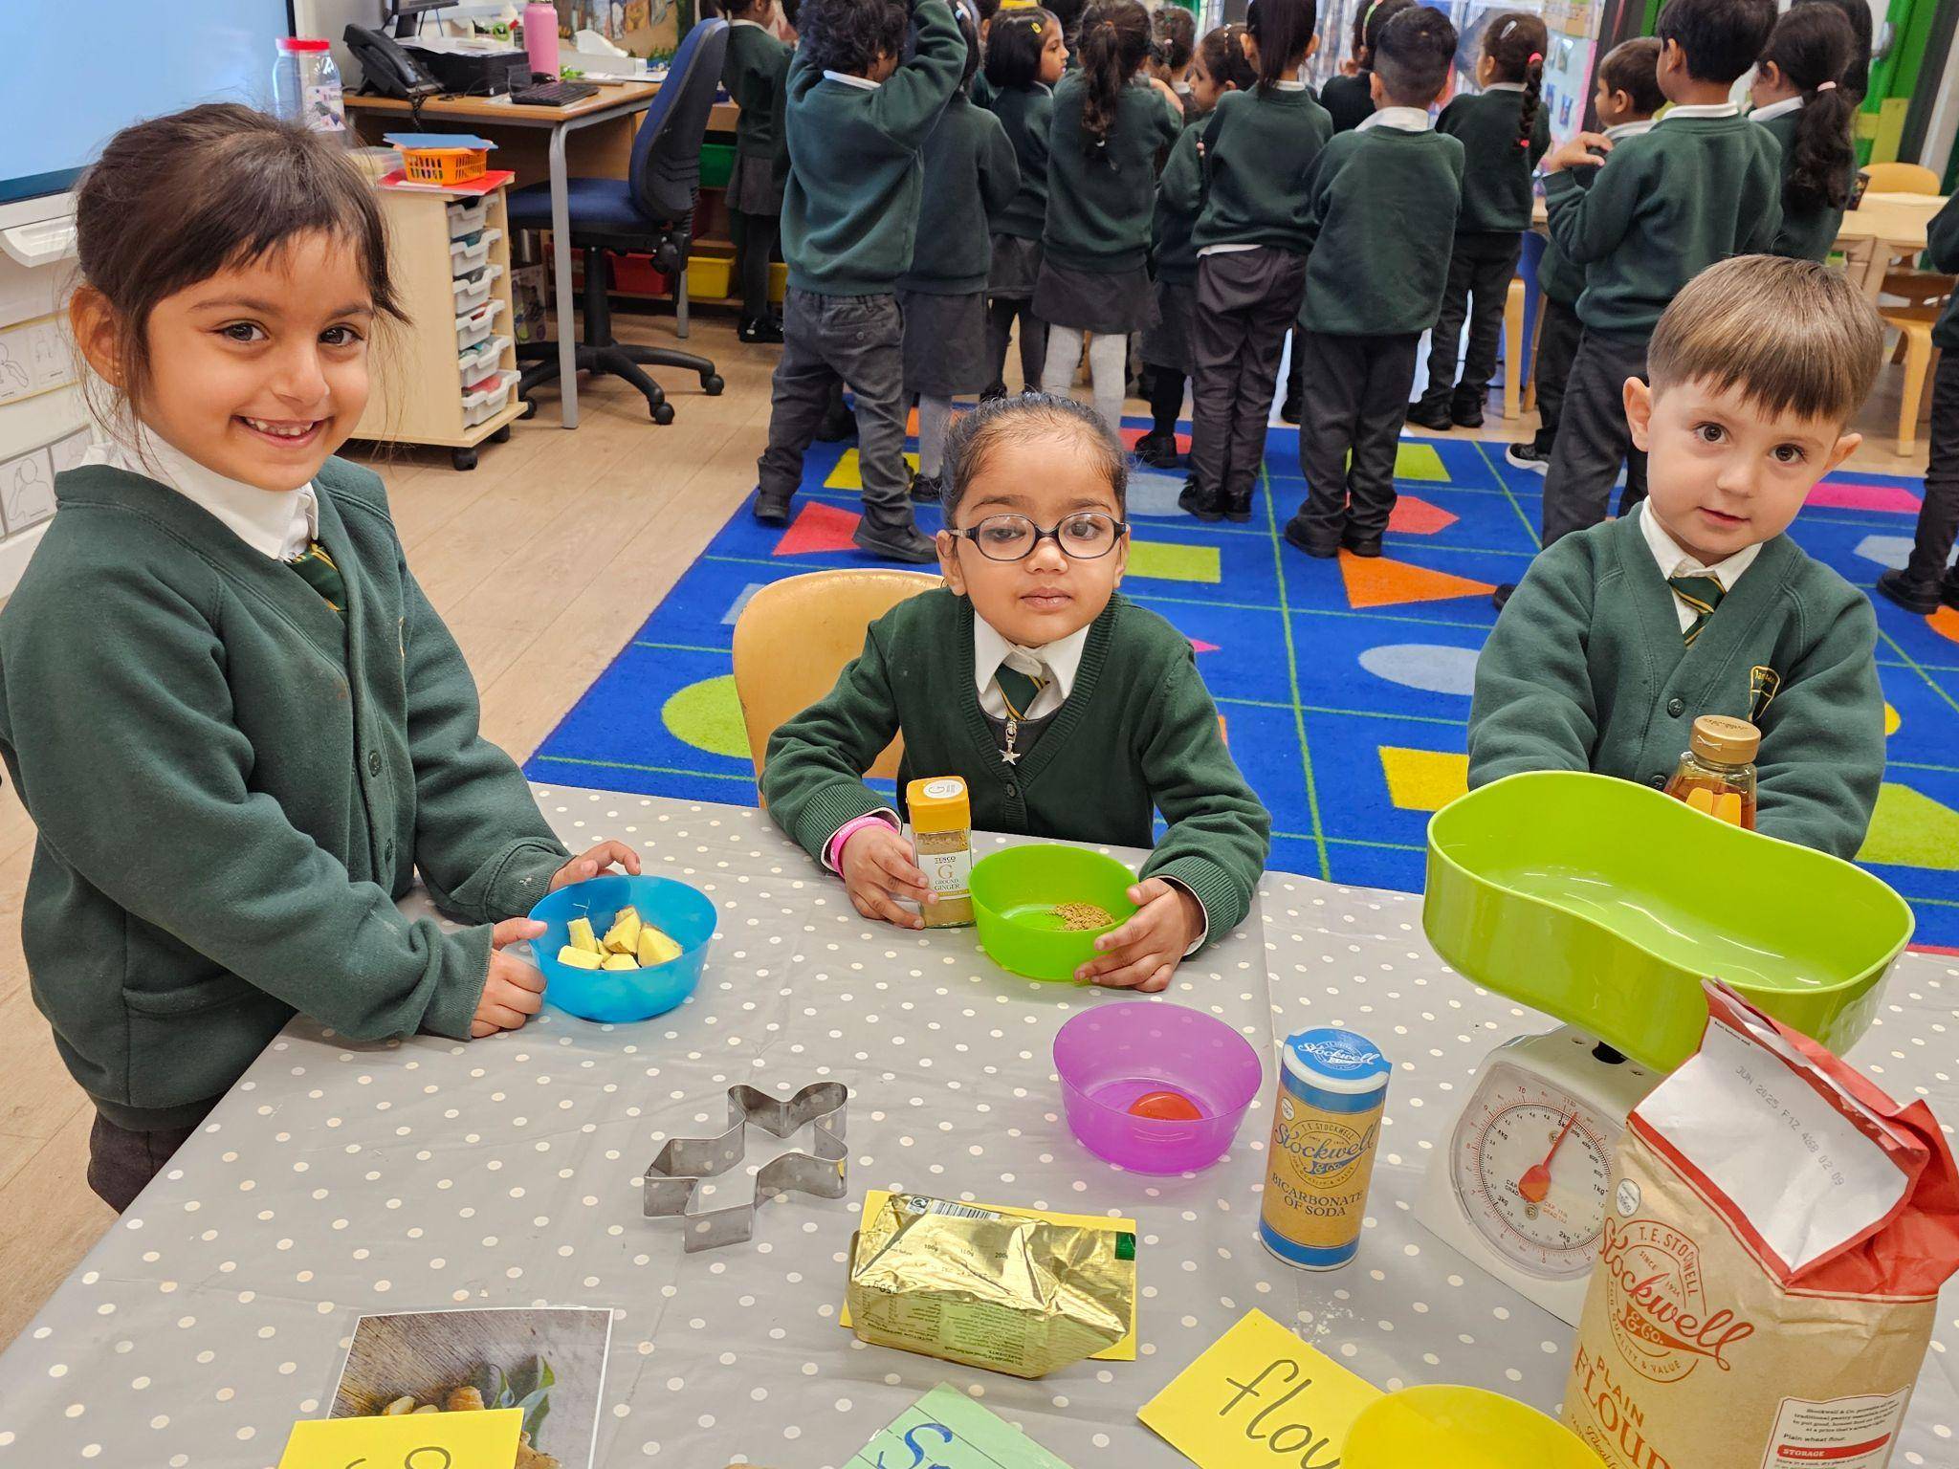
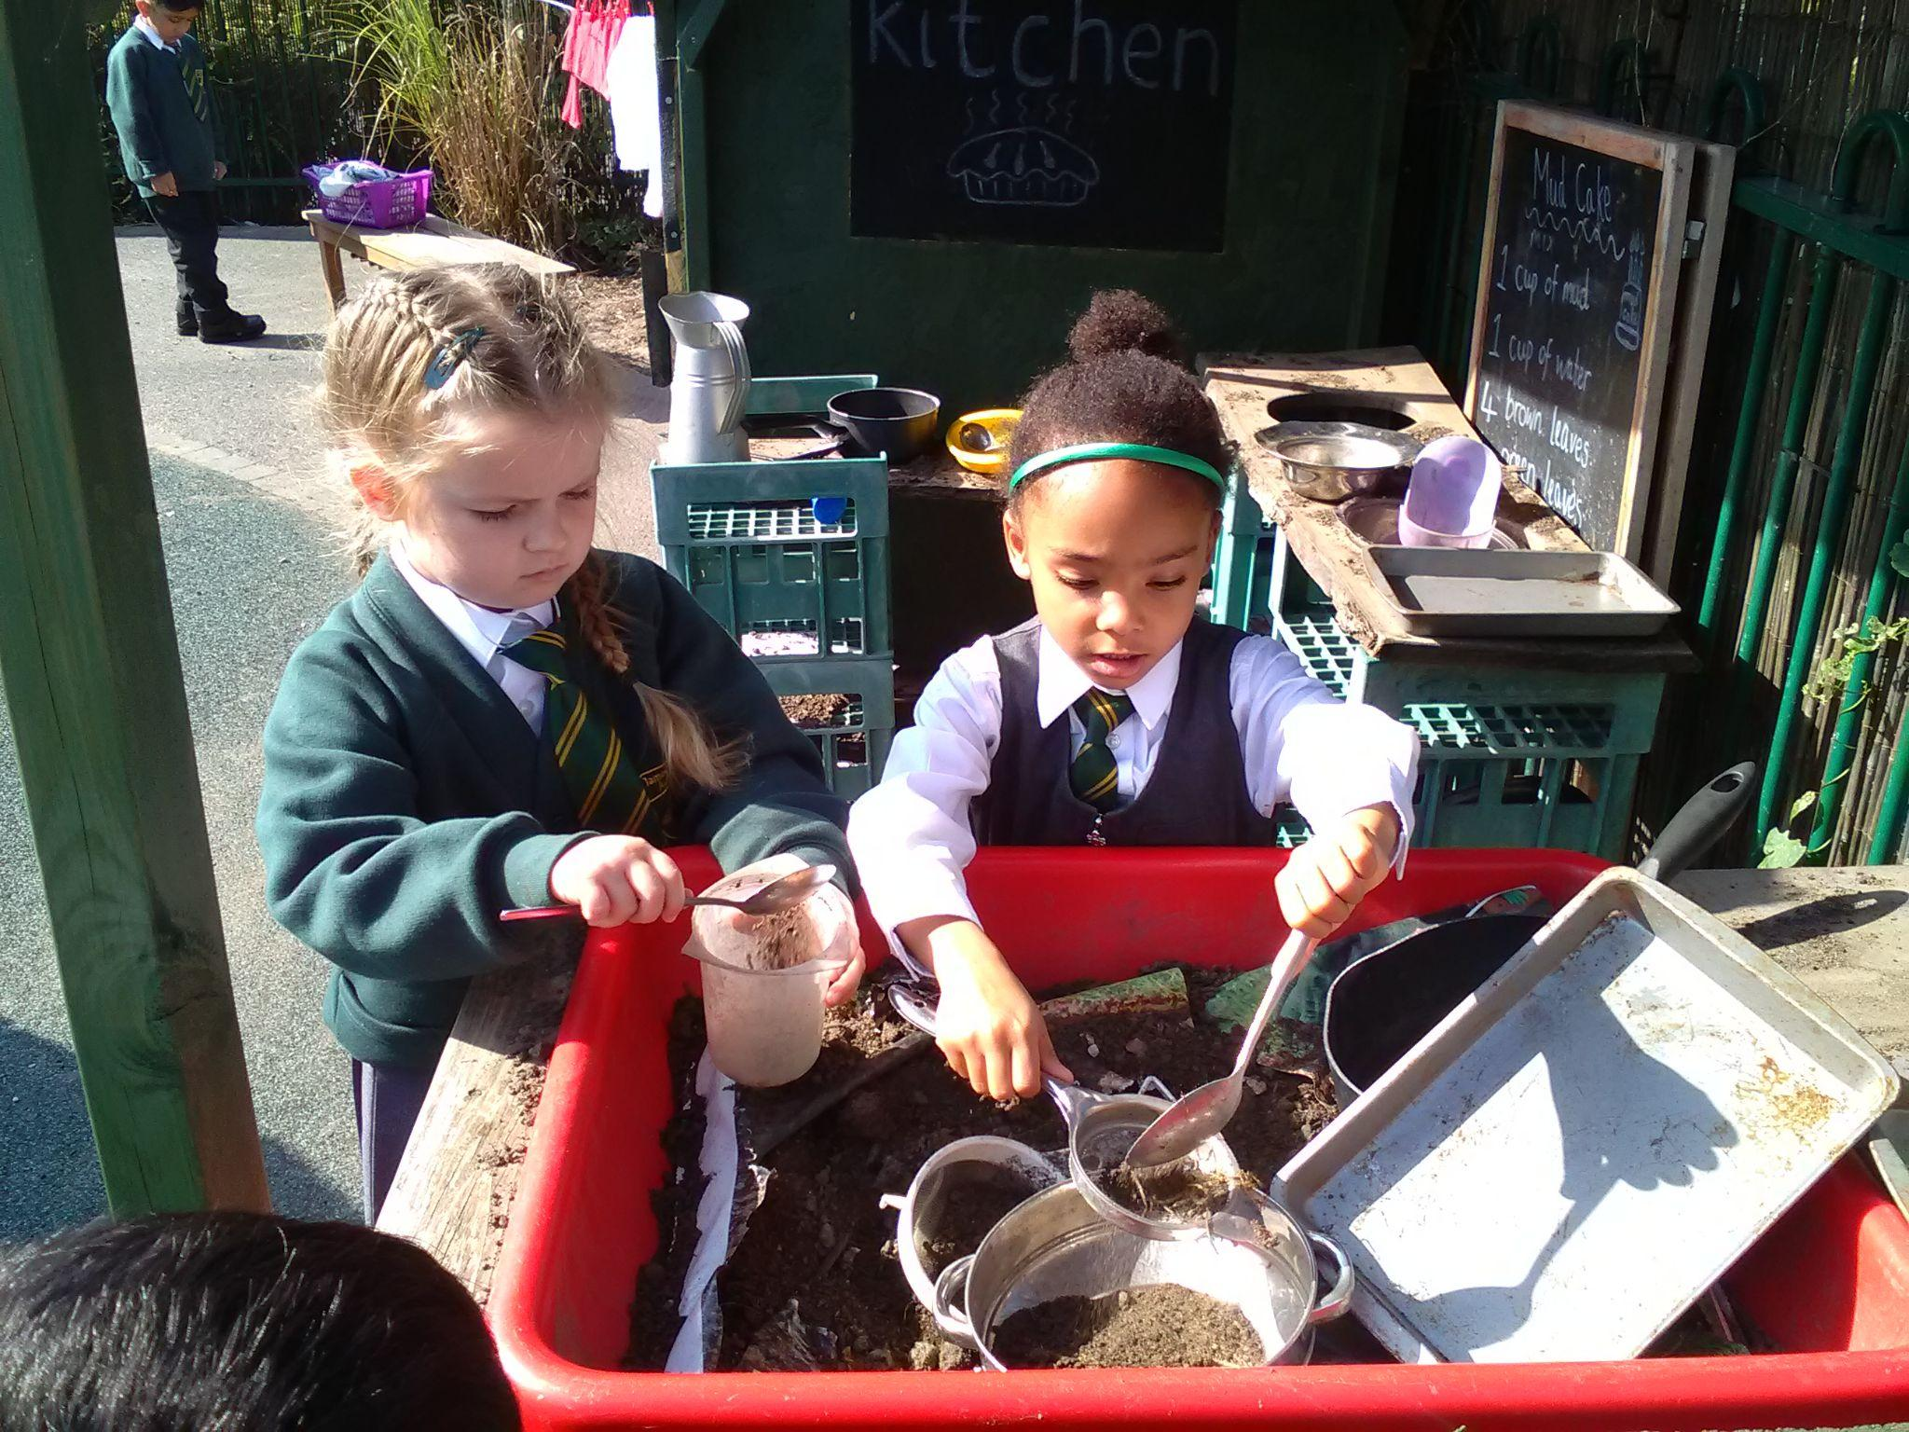
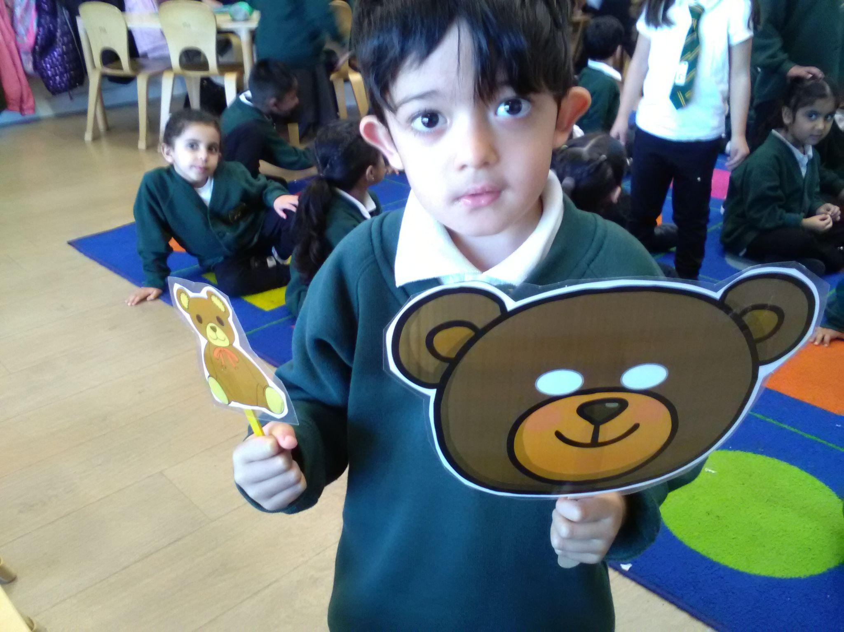

Reception have displayed the value of Resilience and the skills of problem solving, aiming high & staying positive in the following ways:
Saying goodbye at the gate to their parents and walking independently to their classes.
Asking for help when they face challenges or things that they're unsure about.
Expressing their emotions by either using the wellbeing board or talking to adults.
Solving problems by exploring different approaches to tasks and not worrying about making mistakes.
Recognising that making mistakes is part of the learning process.
Practicing writing their names daily.
Learning to listen to their teachers.
Asking questions.
Becoming more efficient at finishing their lunch.
Learning to use ‘please" and "thank you.’
Collaborating to share ideas and solve problems.
Following classroom rules.
Last but not least, some children are making a great effort to attend school every day, even when they might feel a bit under the weather.

Slide 5
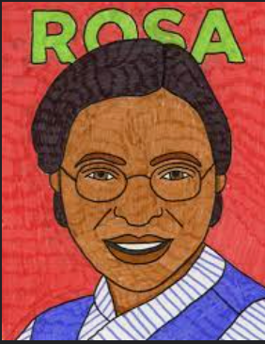
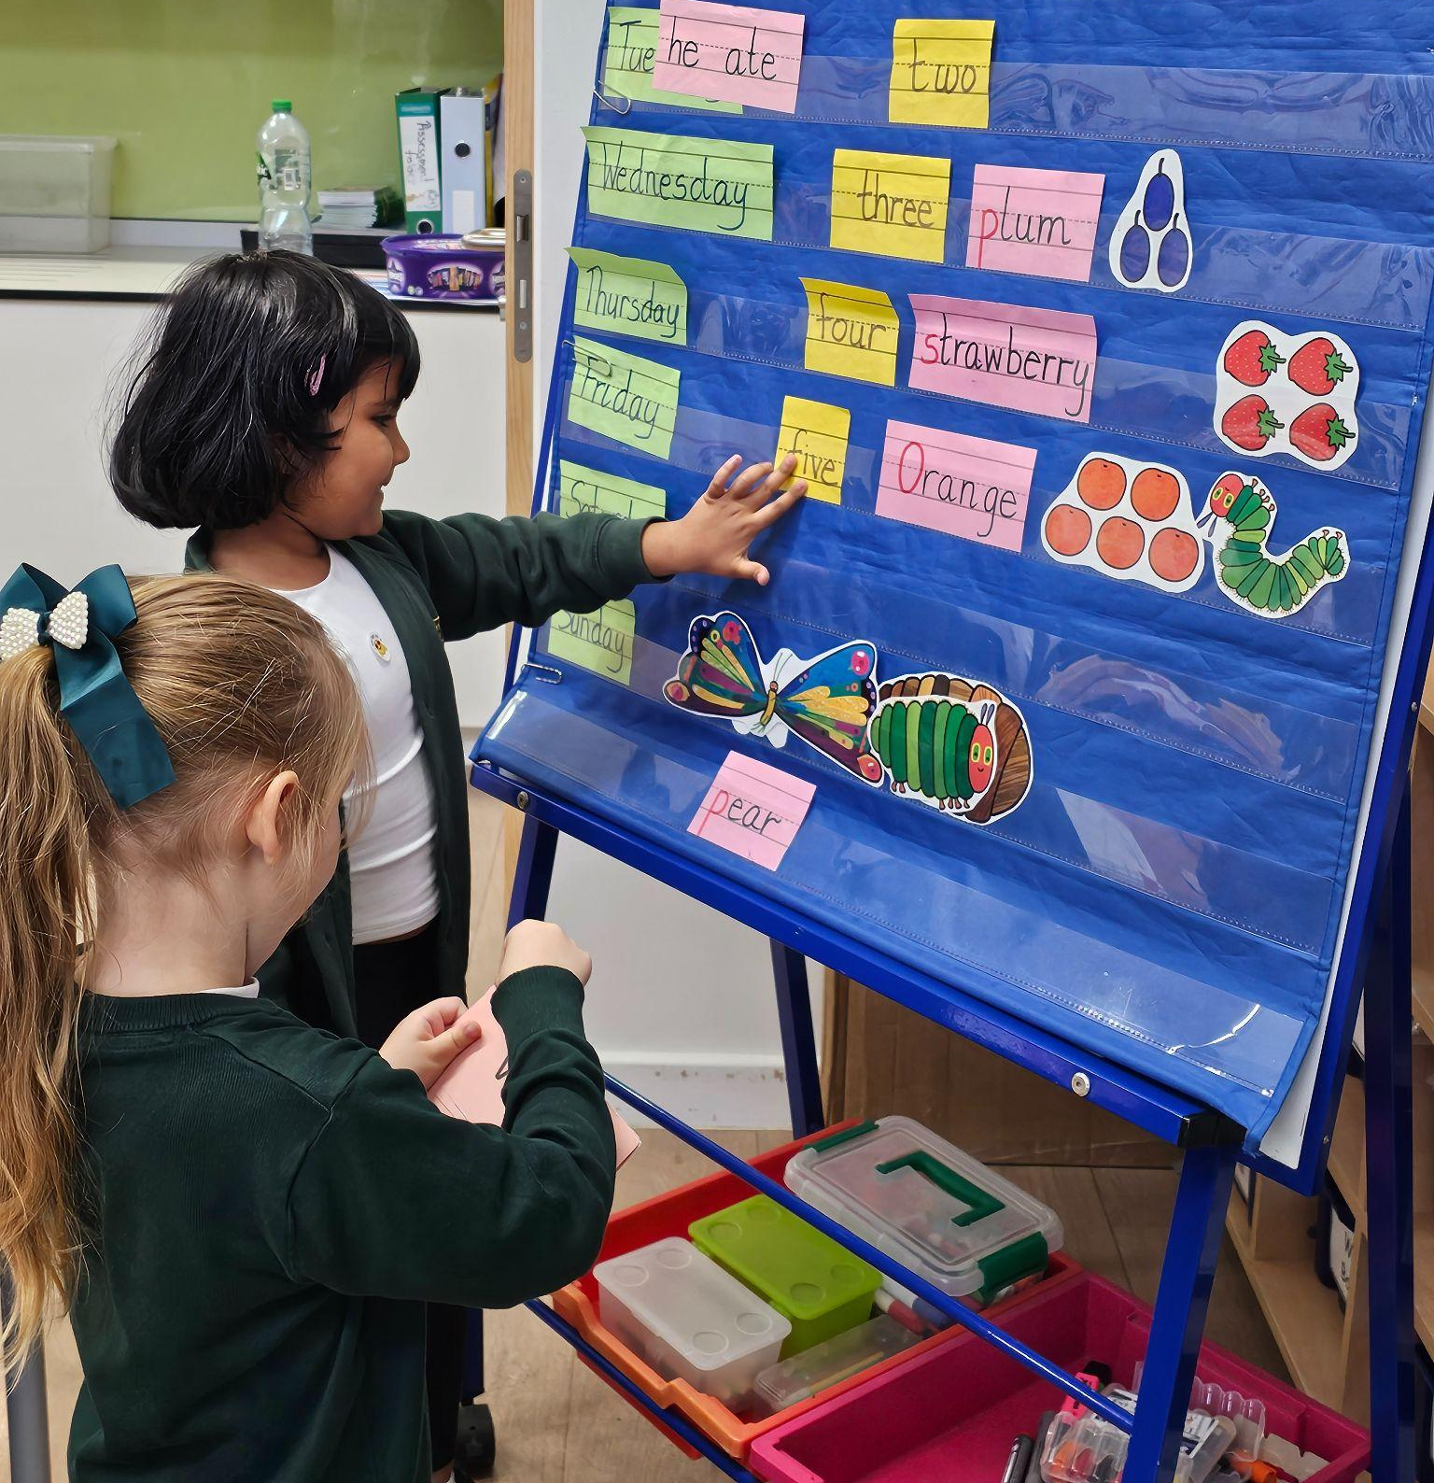
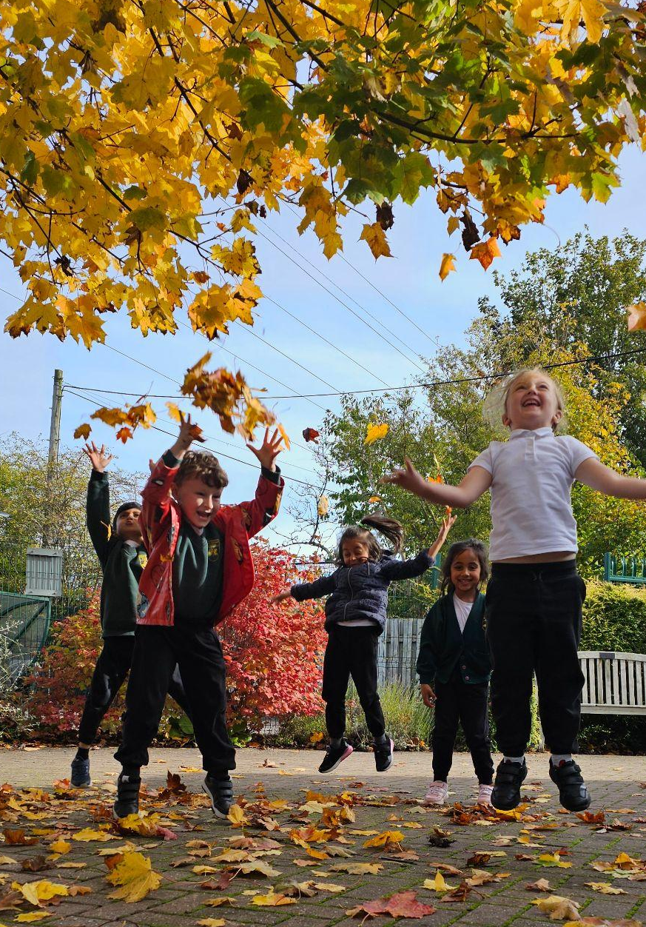
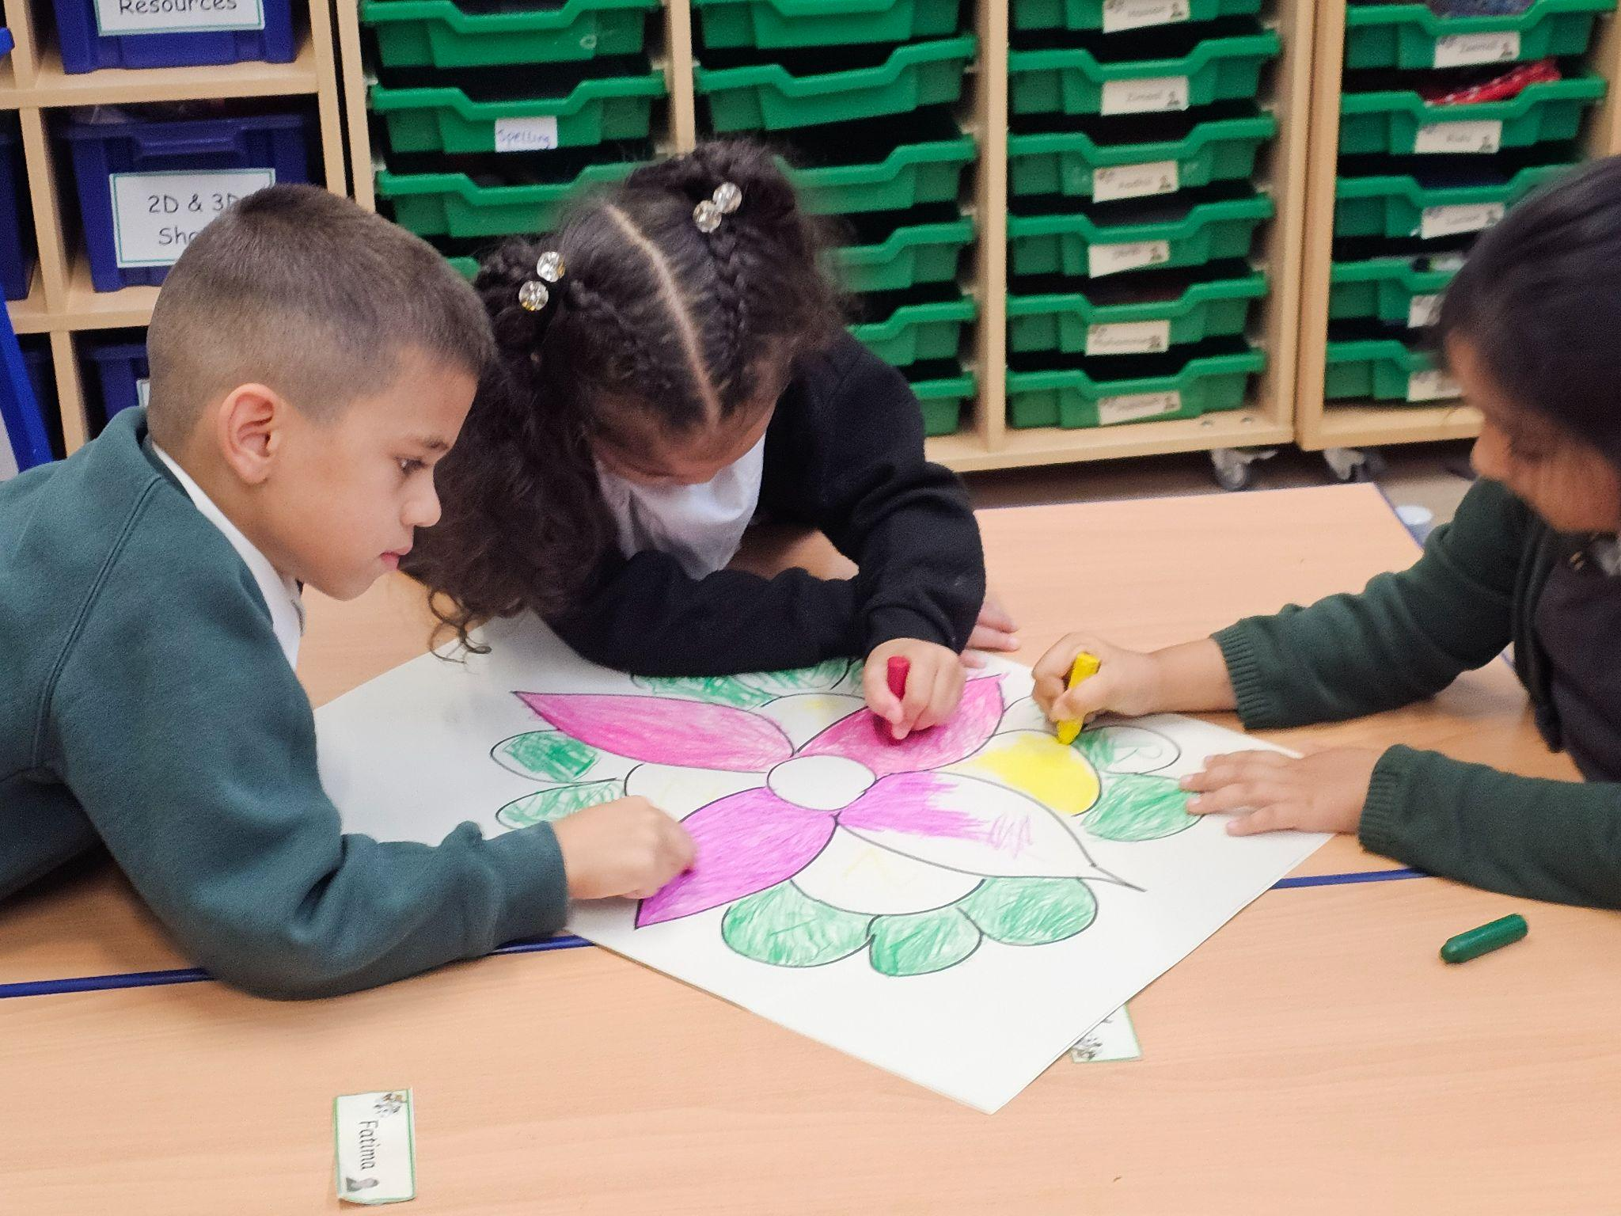
Year 1 have displayed the value of Resilience in the following ways:
We celebrate Resilience by …
In Reading we practiced resilience by trying again when we came across a problem that was difficult. We learned to use teamwork and problem solving to overcome a problem.
In Foundation we learned about the life our Rosa Parks. She showed us how to be resilient by staying positive in the face of adversity. We learned to stand up against injustice and fight for what is right.
In Science we learned that nature is changing with the seasons. We can show resilience by taking walks in nature and dressing up to adapt to the weather
In R.E. we learned about resilience and how light conquers darkness with the hindu festival of Diwali. We made Rangolis to show this.
This Term we incorporated the value of resilience by promoting our skills builders values and a growth mindset in everything we do.

Slide 6
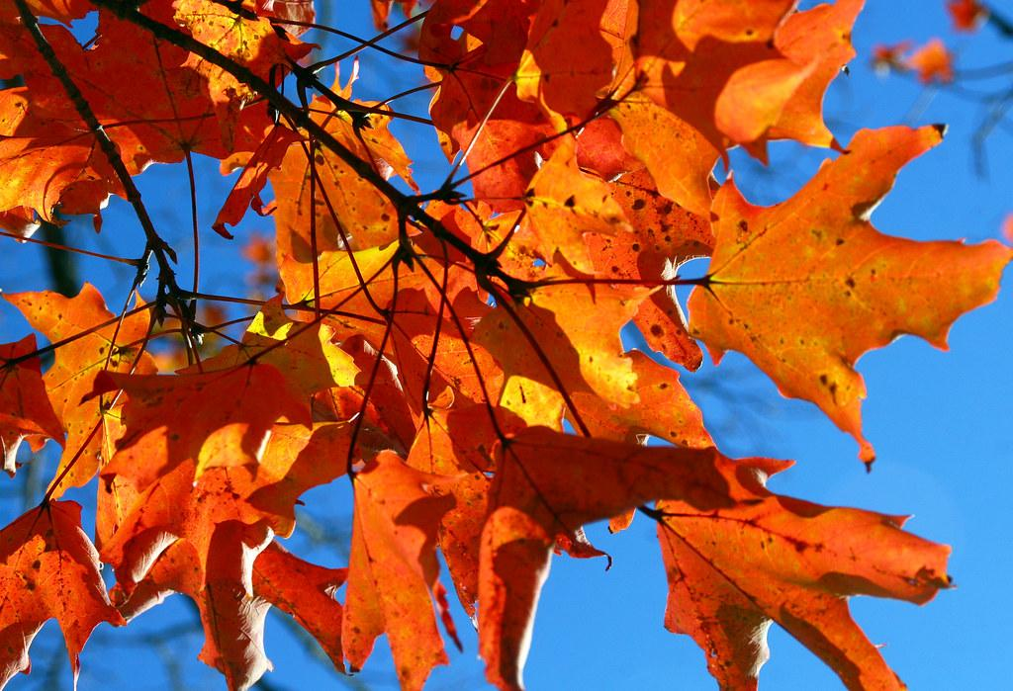
Year 2 have displayed the value of Resilience and the skill of problem solving, aiming high and staying positive in the following ways:
Trying hard in all lessons even when we found something hard. Creativity
Being flexible and trying new things to help us learn and grow while exploring the new year 2 curriculum. Problem Solving
Being optimists and coming to school with a smile on our face, feeling happy to start a new day. Staying positive
In RHE we learnt about ‘Being me in the world’. We learnt how to accept ourselves and others, and how to keep confident, and stay positive about the future. We also learnt how learn from our mistakes and how to accept the consequences of our actions and become more responsible. Listening
Improving our work through addressing mistakes and correcting them. Creativity
Asking for help when we were stuck. Coming or staying in school when we felt a bit under the weather (when having a slight headache or a tummy ache or if we had a fall on the playground and we got a cut).Staying positive
Being patient and not giving up when something didn’t go our way or to plan. Teamwork

Slide 7
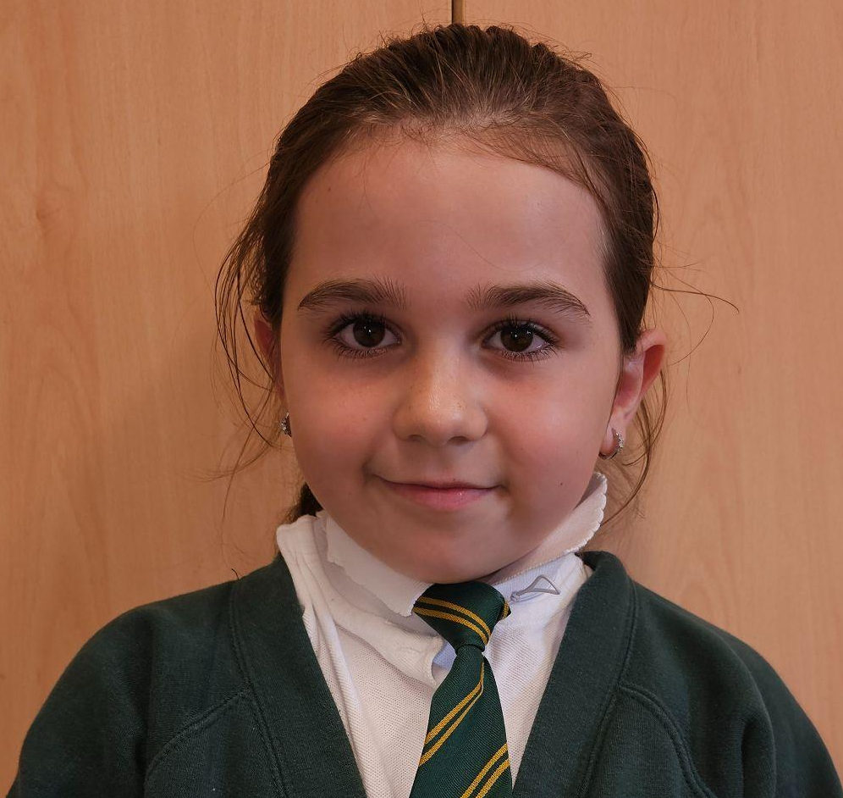
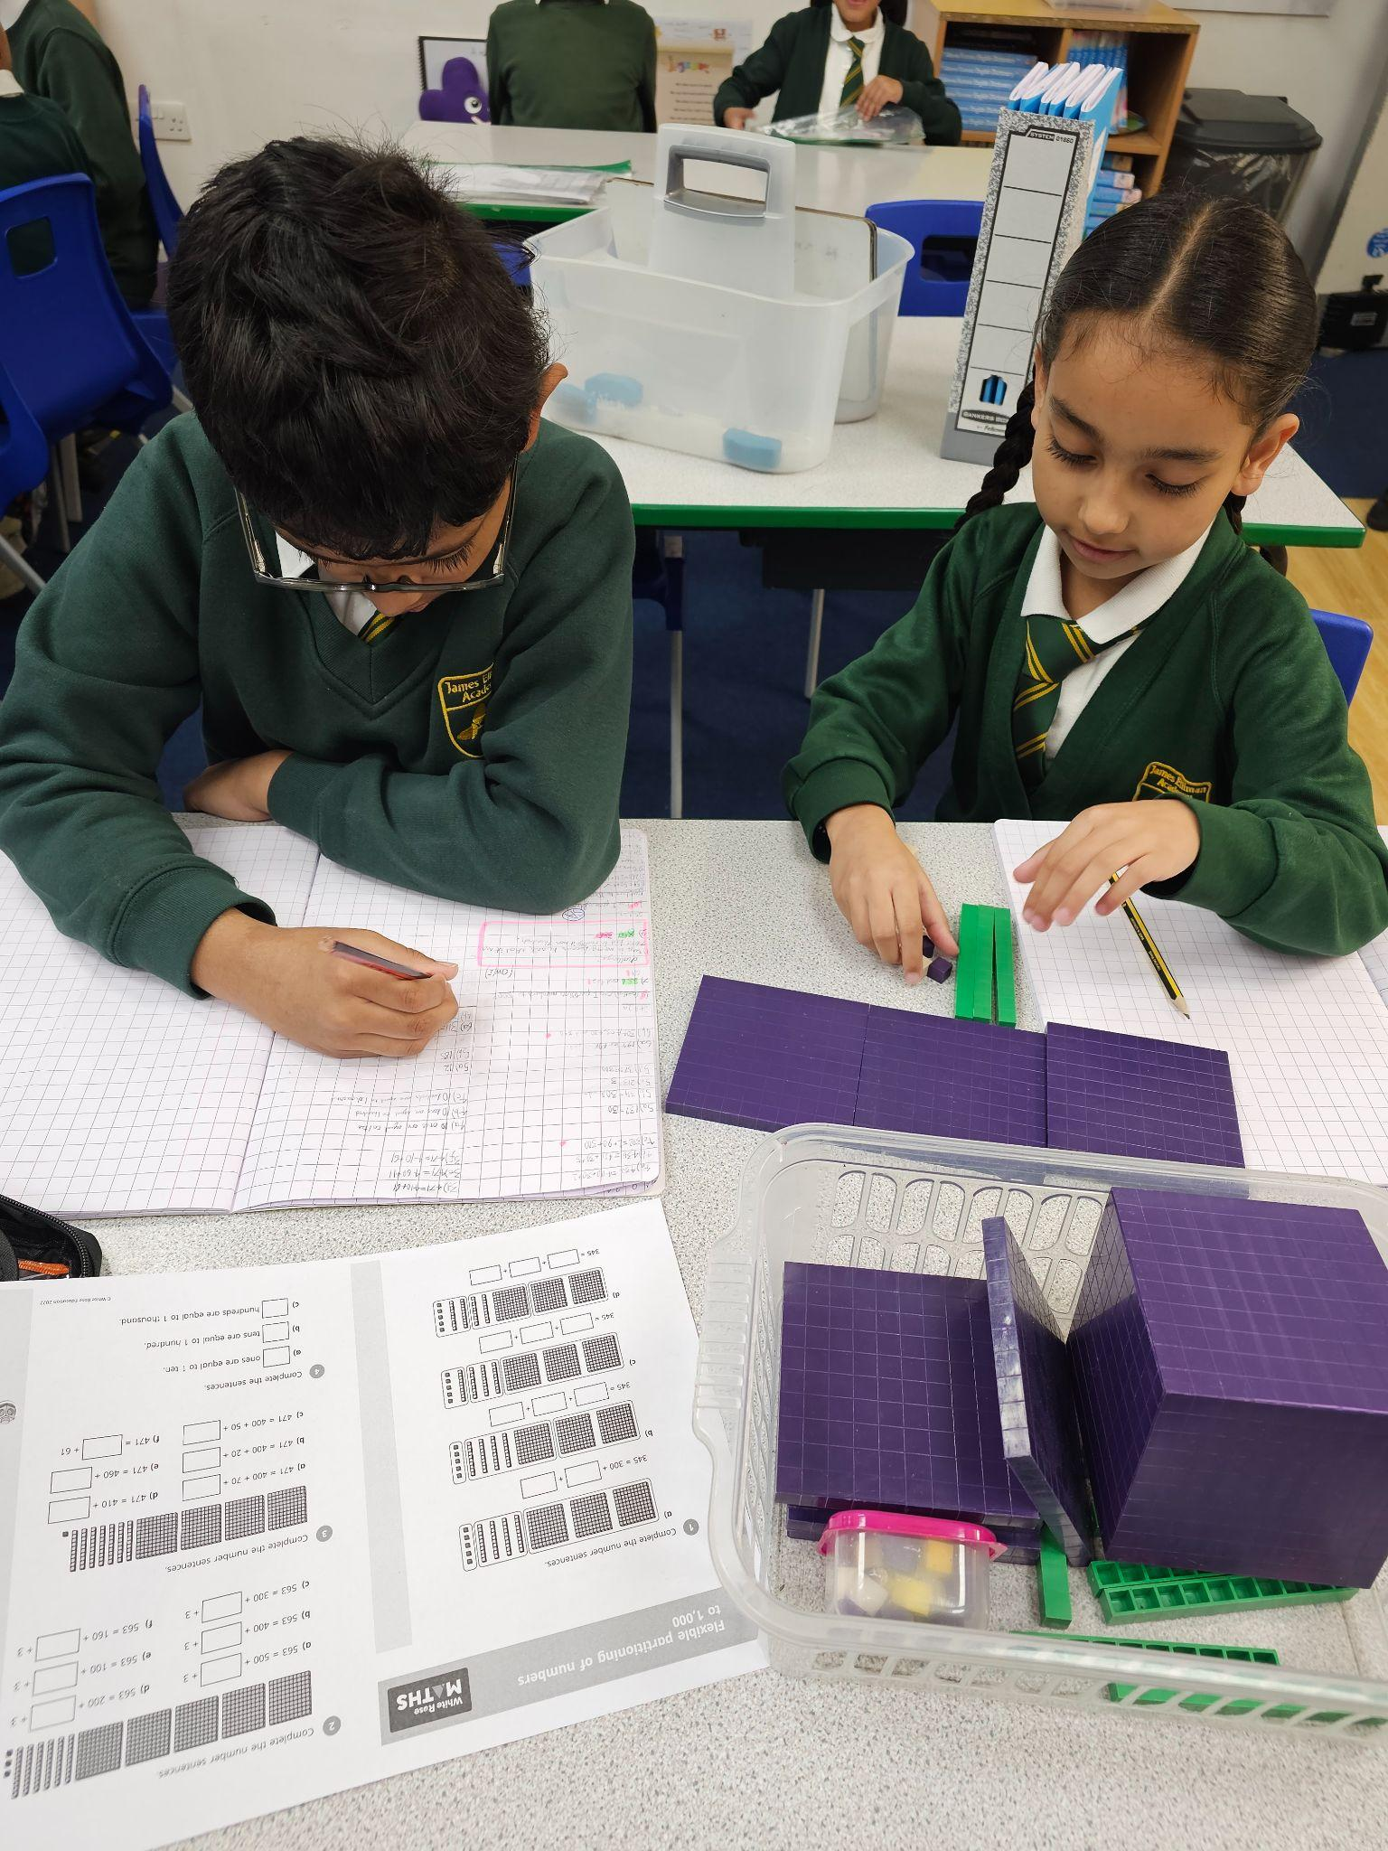
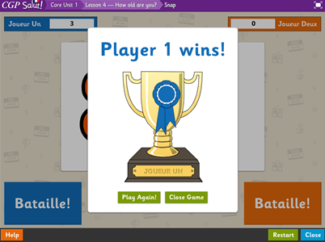
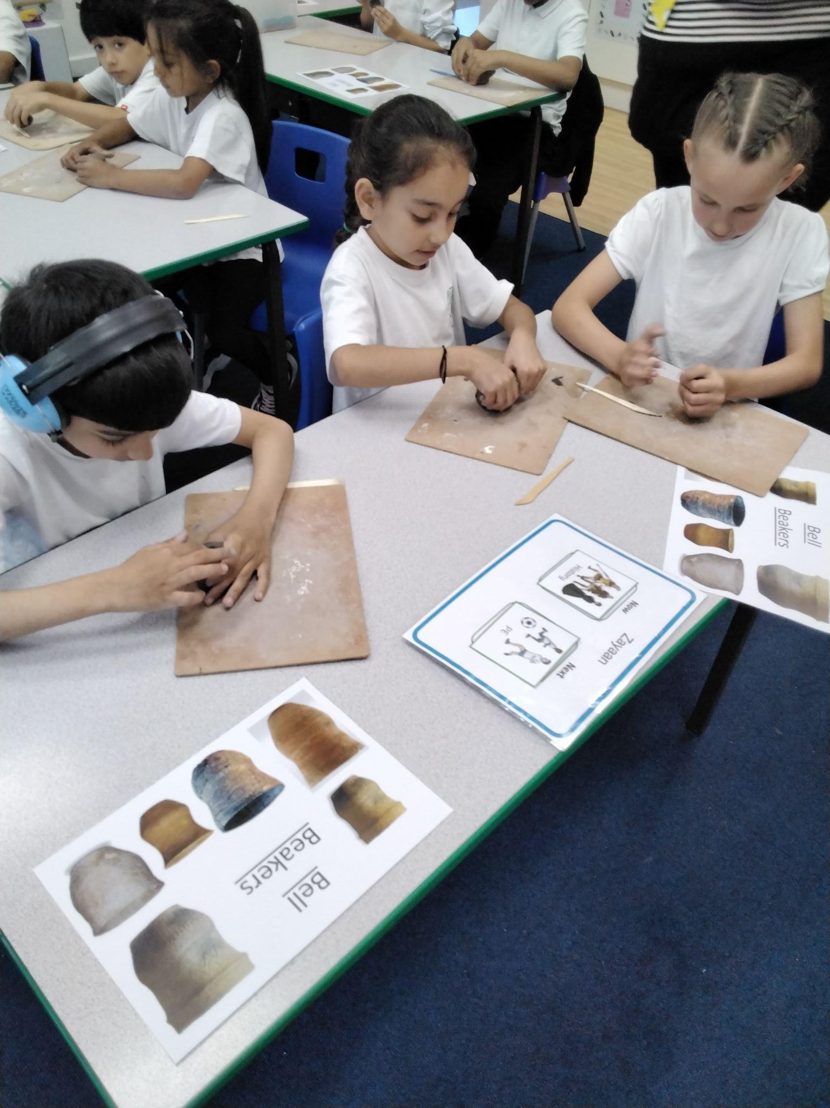
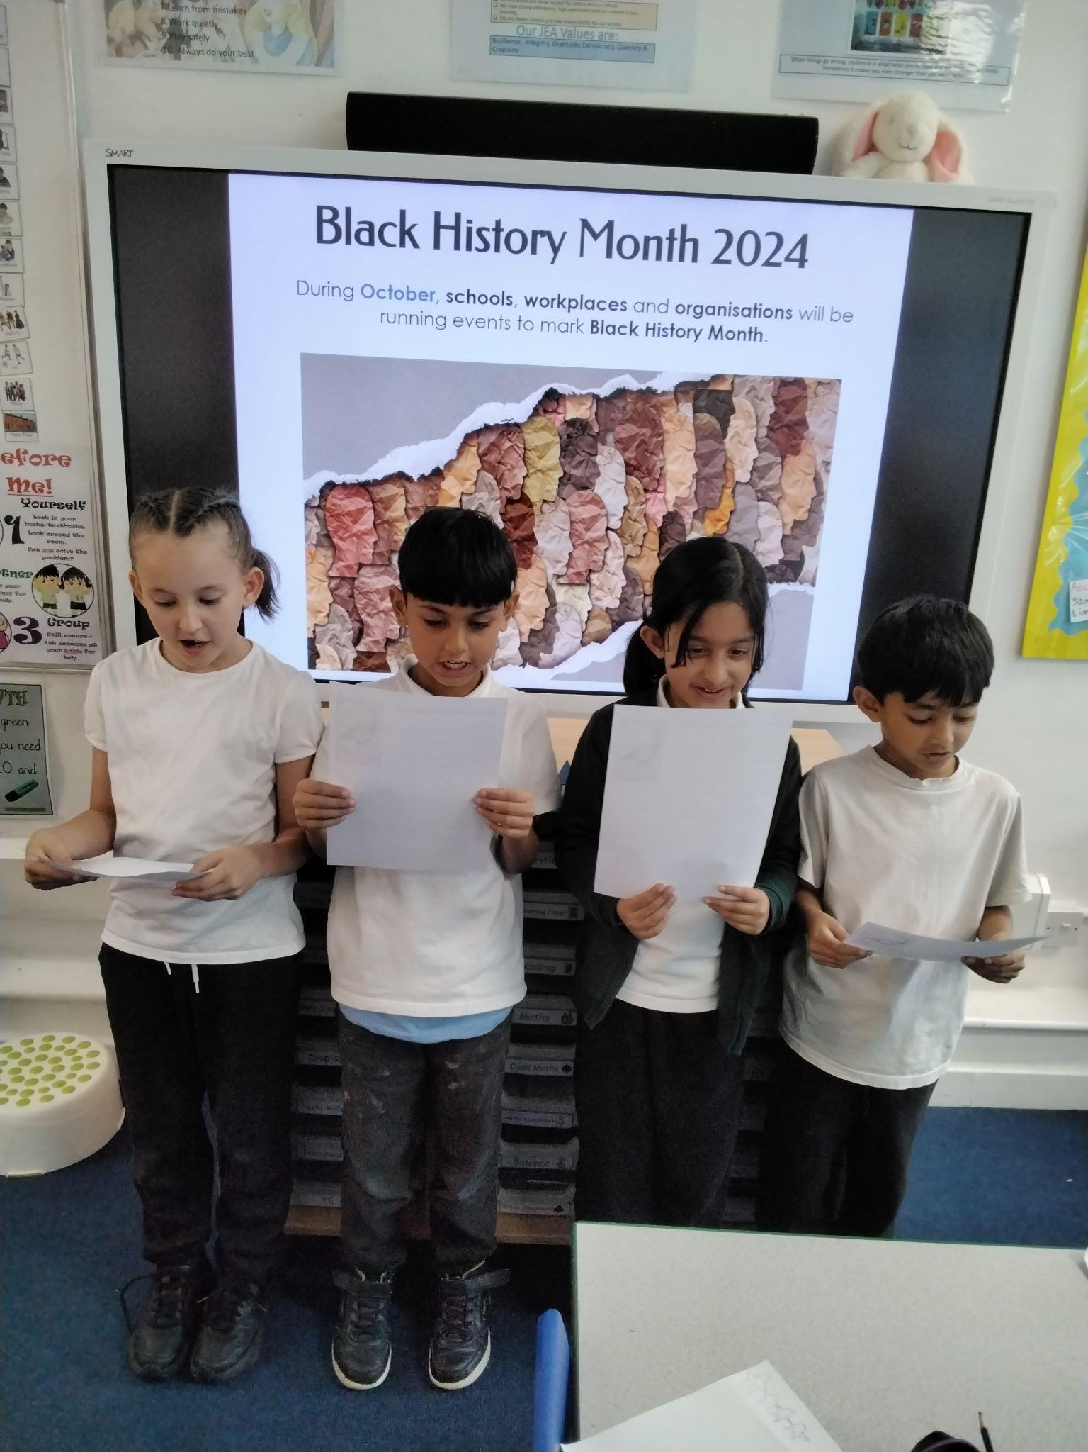
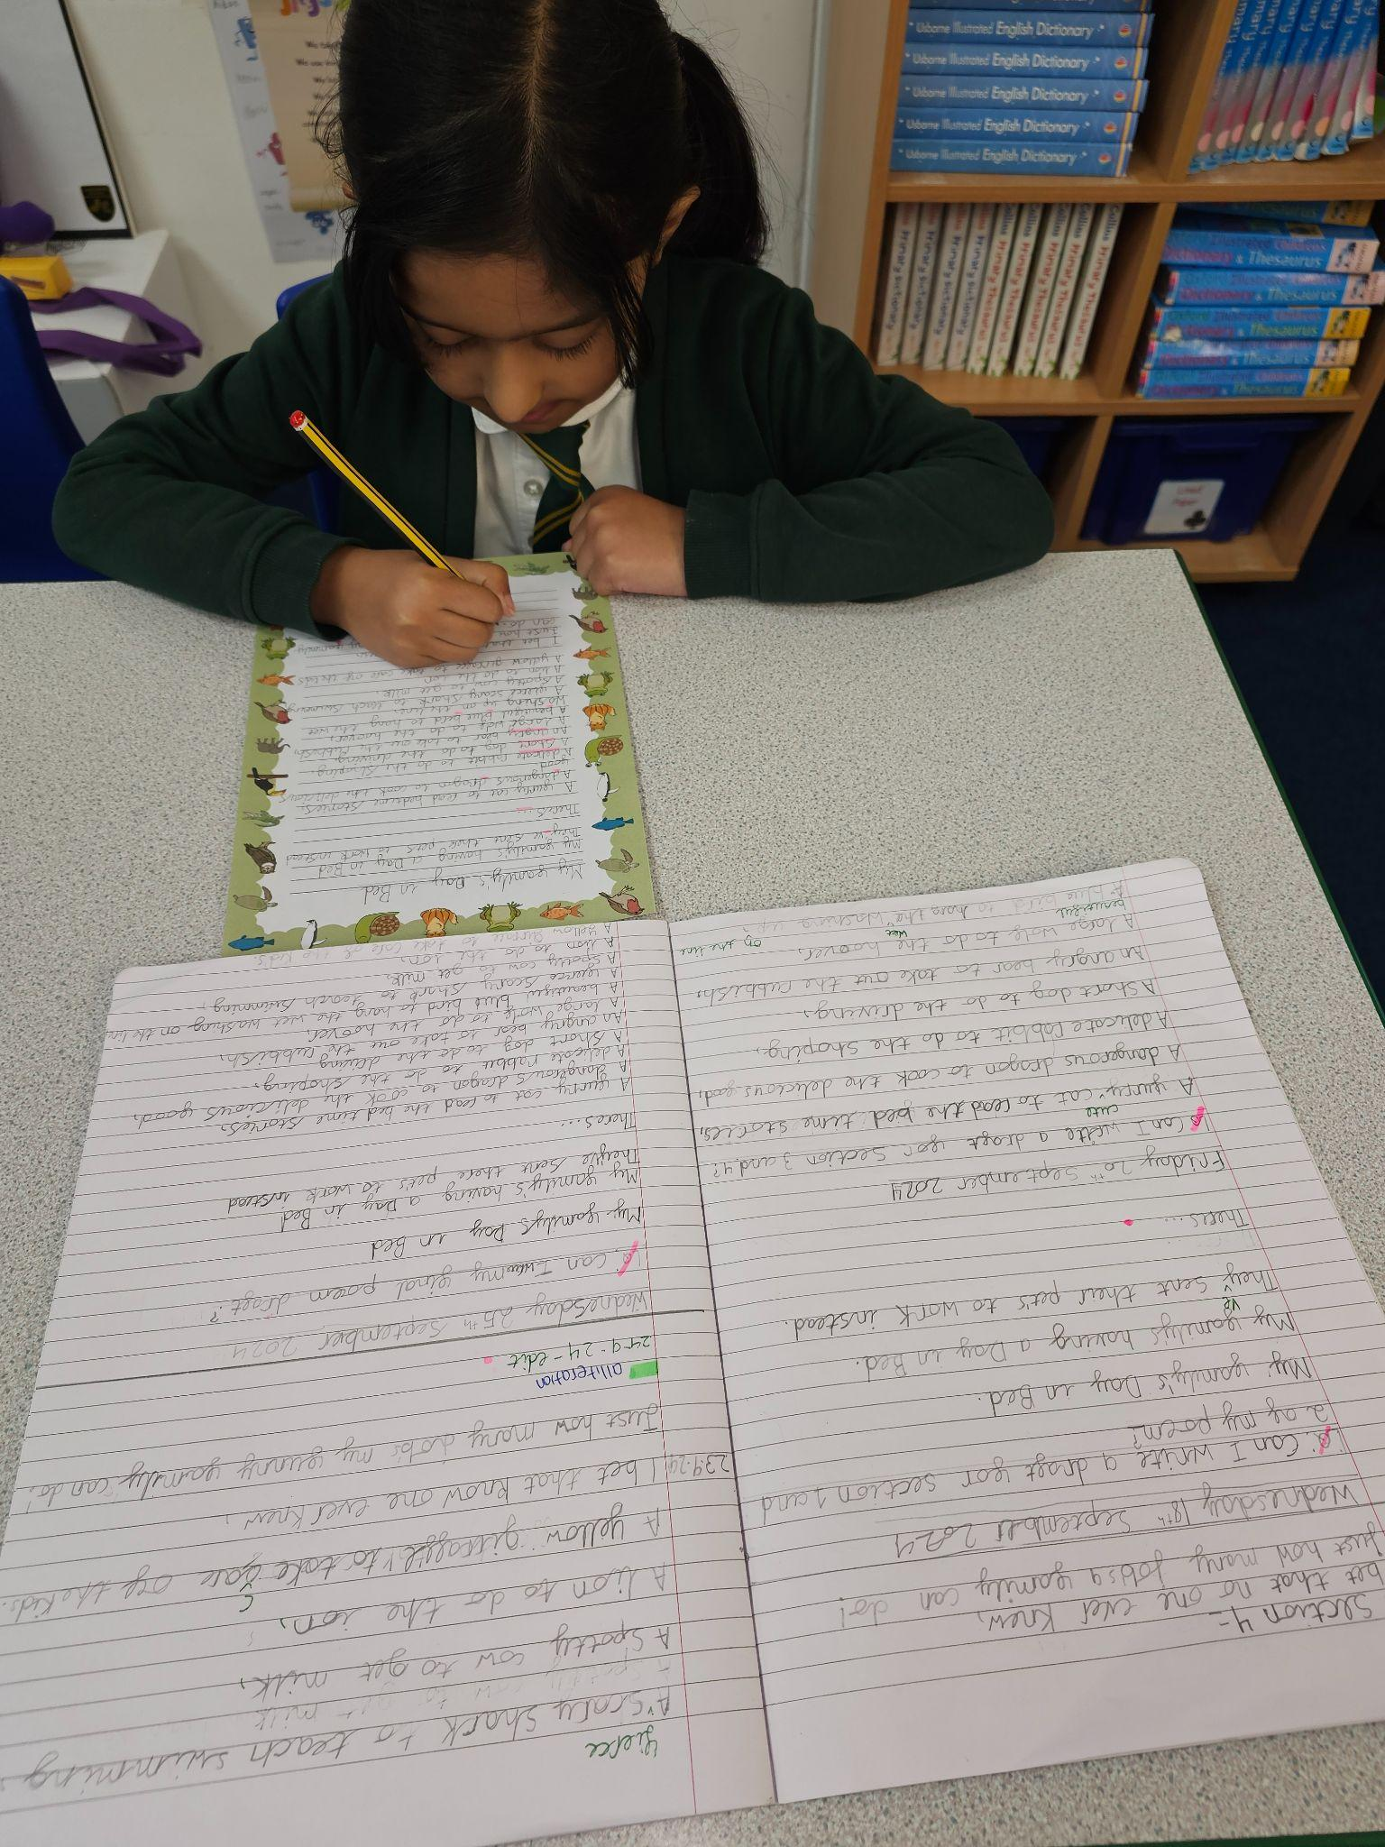
Year 3 have displayed the value of Resilience and the skills of problem solving, aiming high & staying positive in the following ways:
WE ALWAYS TRY OUR BEST AND NEVER GIVE UP!
Smile
We come to school confident each day and always try to stay positive.
Clay work in History
We were resilient when shaping our clay into a Bell Beaker. We did not give up and kept reshaping until we achieved it.
French
In year 3, we have started to learn French. We have shown resilience by trying our best even when we find it difficult and sometimes forget the words. We stay positive by playing the French games which helps with our vocabulary.
Maths
We have been trying hard, particularly in maths, to work on our problem solving skills. This has also shown we are resilient as we keep going, use the resources if needed, until we get the correct answer.
Black History Month
We celebrated the Poet Maya Angelou. We explored and performed the poem ‘Life doesn’t frighten me at all’ which focuses on
staying positive.
Handwriting
We are focusing on aiming high with the standard of our presentation in our work by practising our handwriting and ensuring our work is neat at all times.

Slide 8
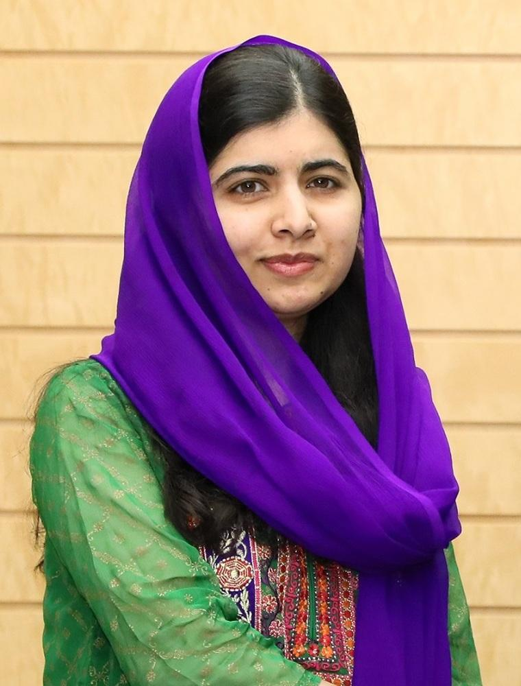
Year 4 have displayed the value of Resilience and the skills of problem solving, aiming high & staying positive in the following ways:
In year 4 we have been studying our significant person, Malala, we have learnt alot from her, in how to use our problem solving, and staying positive to continue to aim high and believe in ourselves and strive to achieve, what is important to us.
Year 4 have been working on resilience through:
Trying their best in everything they do, even if they find it difficult. (Staying positive)
Accepting the challenge of the year 4 curriculum.(Aiming high)
They are learning to support each other in their learning and play times.(Problem solving) Saying NO! To bullies. Team work
Year 4 children have worked on their problem solving skills by using their friends to help them when they find work or situations challenging. They have been learning about how to cooperate with each other and used teamwork skills to help each other.

Slide 9
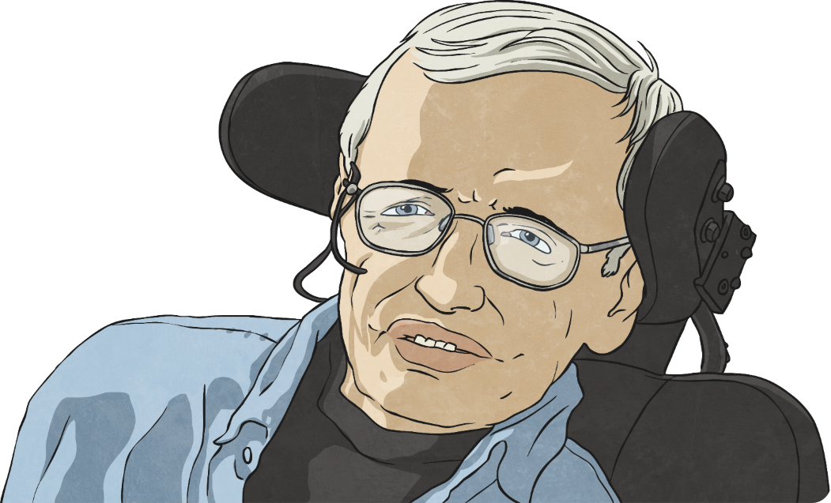
Year 5 have displayed the value of Resilience in the following ways:
Problem solving and using our friends to help us; cooperation and teamwork with each other is so important.
By talking about the issues which trouble us or make us frustrated either to our friends or an adult or being a good friend/learning partner and listening.
Showing good learning behaviour when faced with a difficult task in lessons and use creativity to use problems in a unique way. .
Staying positive and reflecting on what went well during a lesson and what needs to be done to move on to the next step.
Stephen Hawking
Stephen Hawking demonstrated great resilience by not giving up, even after getting very sick with ALS.
Despite being unable to move, he continued to make important discoveries about space and the universe.

Slide 10
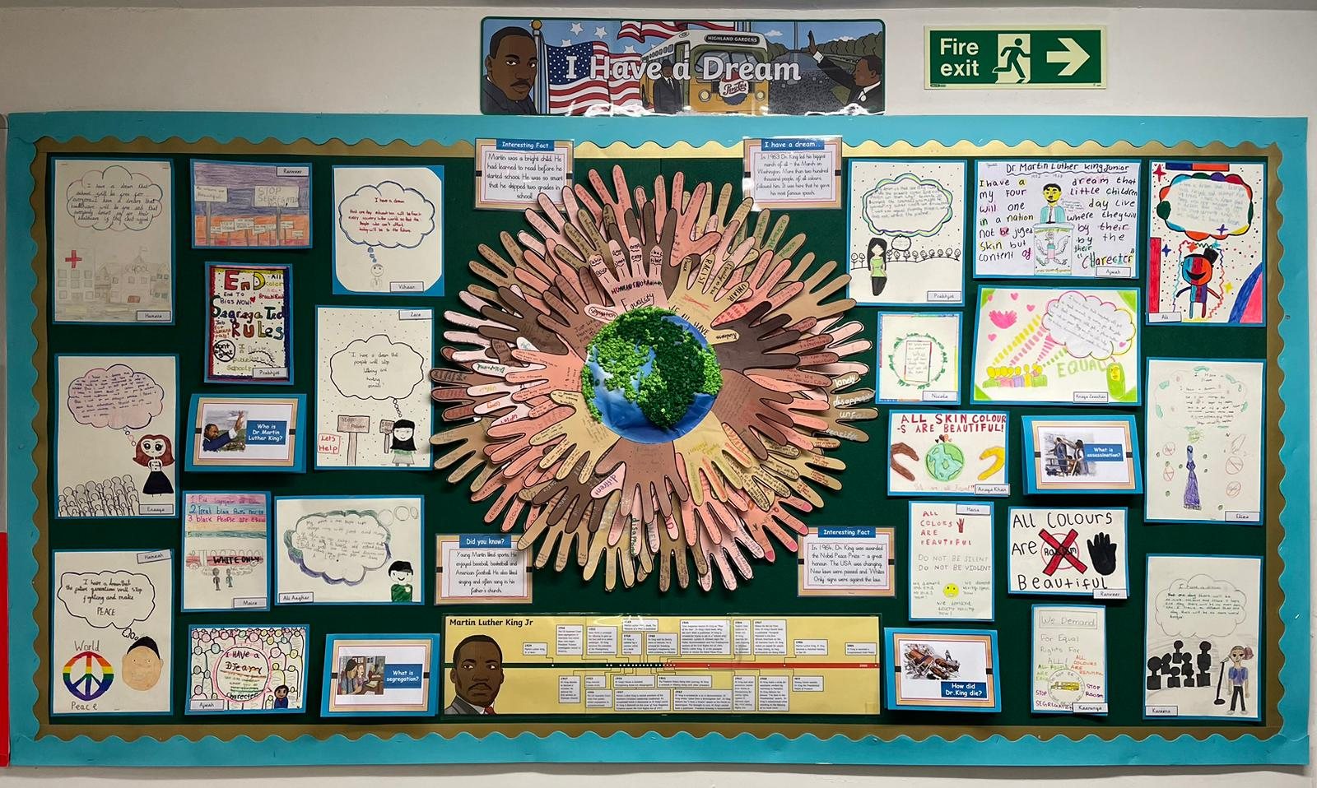
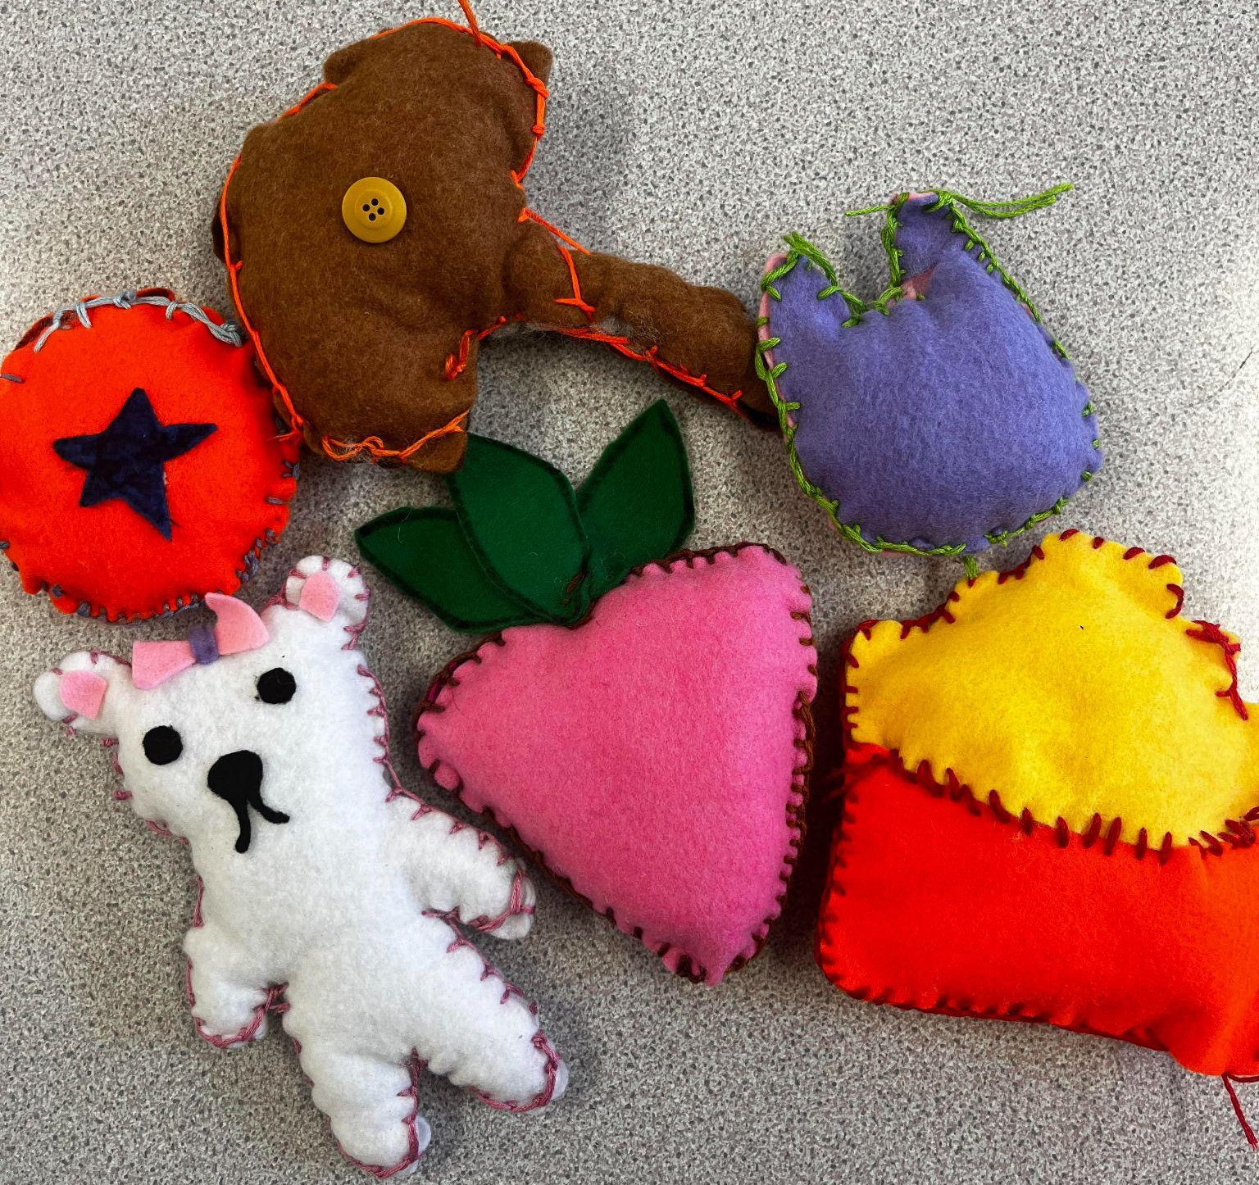
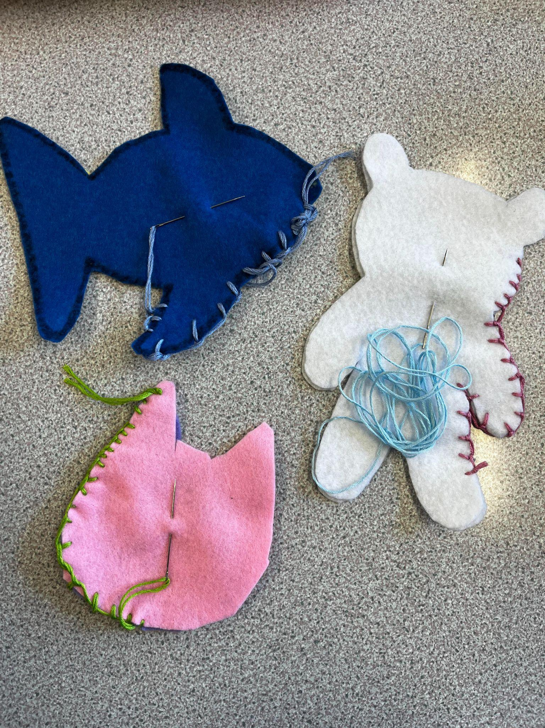
Martin Luther King Jr
Year 6 have learnt all about Martin Luther King Jr this term. We listened to his ‘I Have a Dream’ speech which is all about equality and fighting for justice.
He taught us to be resilient in the face of adversity, to stay positive and to always fight for the right thing. He taught future generations to know what they deserve and to never settle for less.
In Design and Technology, all the Year 6 children displayed impressive resilience while learning the blanket stitch. Although many found the technique challenging at first, they showed great determination, practicing and refining their skills over time. With patience and perseverance, each child mastered the stitch and went on to create some truly amazing pieces.
Year 6
Resilience
Black History Month
In reading, we studied an extract titled "Hidden Figures" by Malorie Blackman. This text showcases how resilience is a vital trait in the face of adversity, as these women demonstrated incredible determination to overcome both racial and gender discrimination. Their stories can serve as inspiring examples for students to develop resilience in their own lives, fostering the strength to overcome obstacles and work towards a more inclusive society.

Slide 11
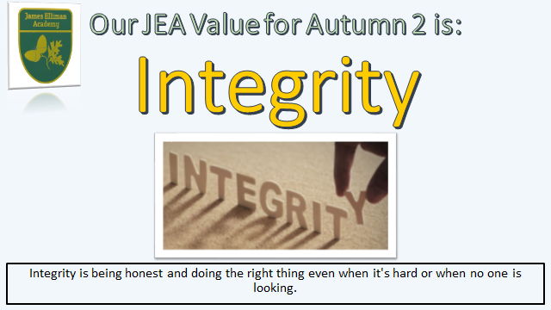

Slide 12


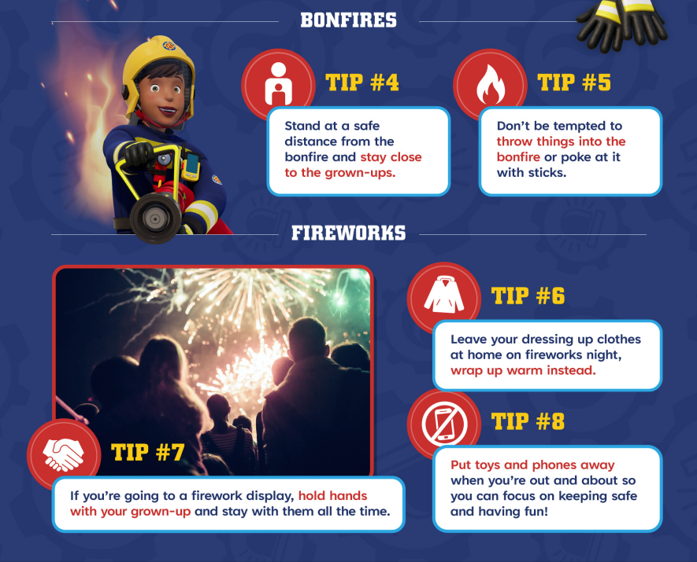

Fire Safety
Diwali and Bonfire Night will be events that many of us will attend in November. These events enjoy the use of fireworks in order to mark the occasion.
Notes:
W/C EYFS / KS1 21/10/2024

Slide 13
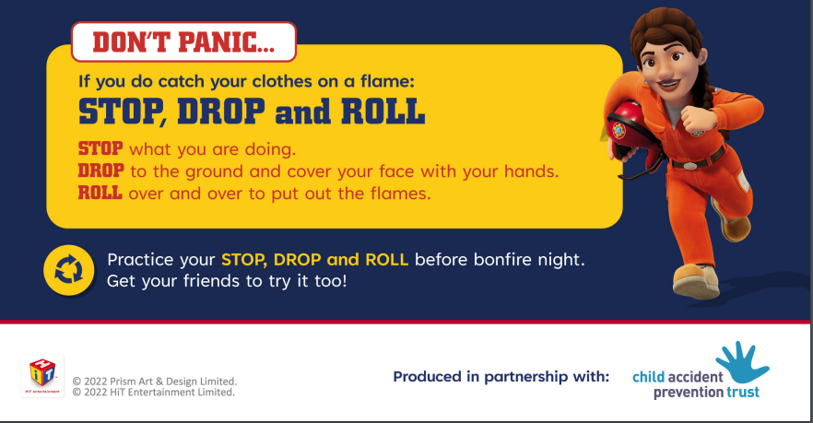
Notes:
W/C 21/10/2024 - EYFS/KS1

Slide 14
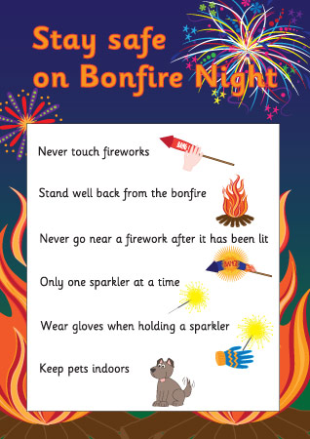

Fire Safety
Diwali and Bonfire Night will be events that many of us will attend in November. These events enjoy the use of fireworks in order to mark the occasion.
In your classes look at the firework/fire safety powerpoints.
Create fire safety posters to help you remember the points.
Assembly video - KS2
British Firework Association
Videos suitable for EYFS and KS1 https://www.youtube.com/watch?v=JTqb8JLgiew
Firework Safety EYFS
Firework Safety KS1
Firework Safety KS2
Firework Safety Quiz
Links for Firework Safety Resources
Firework Safety Hub: Child Accident Prevention Trust
Fire Safety for a safe Diwali
Notes:
W/C KS2 21/10/2024

Slide 15









Charities and fundraising
These chosen local charities have been allocated to each year group who will be raising money to give back to the charities in the community who help so many of our children and families at James Elliman Academy.
Year 4 - Daisy’s Dream
Year 5 - SAFE!
Year 6 - Young Carers
Staff - Alexander Devine Children’s Hospice
EYFS - The Baby Bank
Year 1 - The Cowshed
Year 2 - Parenting Special Children
Year 3 - Rainbow Trust

Slide 16
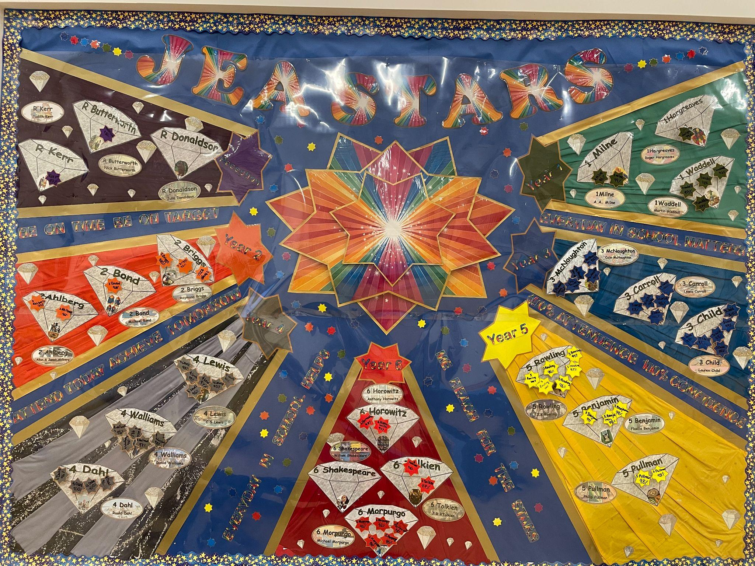
Attendance and Raffles

